Slide 1
Sentiment Classification and EDA on Coldplay lyrics
Lexicon-Based vs Pre-trained LLM

Slide 2
Text Analysis and Sentiment Analysis
Text Analysis is a vast and broad category
Sentiment: Opinion mining (subjective)
Other Text Analysis methods may be objective.
LDA
Clustering
TF_IDF

Slide 3
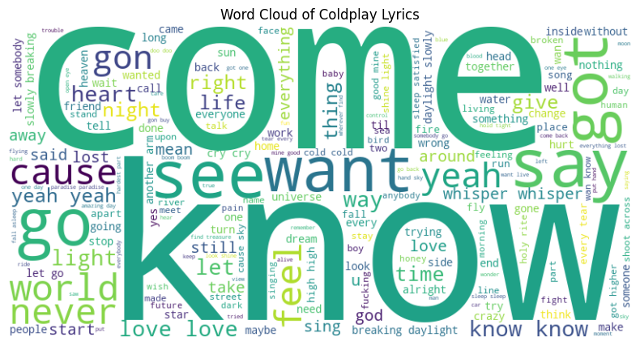

Slide 4
Lexicon-Based (LBSA) with VADER
Expand contractions in text
Preprocess lyrics: (Refined after EDA)
Convert to lowercase
Expand contractions
Remove punctuation and special characters
Tokenize
Remove stop words → CUSTOM stop words.
Lemmatize words
IMPROVEMENT: Part of Speech Tagging.
Perform sentiment analysis using VADER
Extract sentiment scores (negative, neutral, positive, compound)
Normalize compound scores
Classify sentiment into categories (Positive, Negative, Neutral)

Slide 5
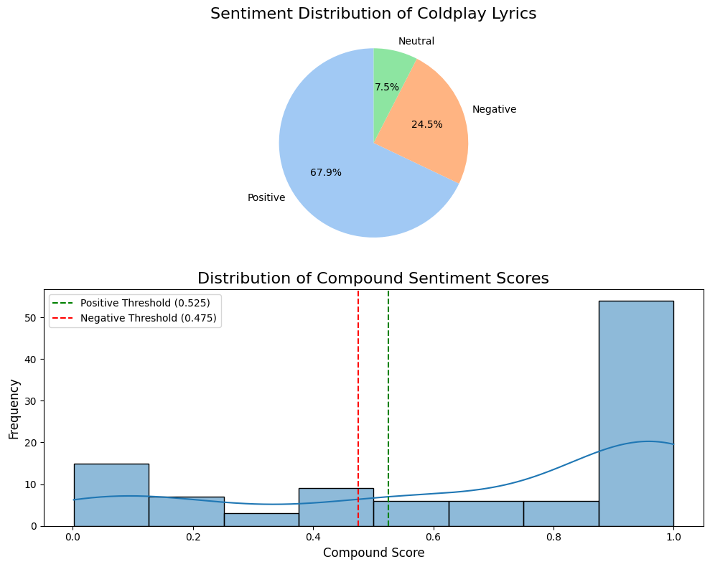

Slide 6
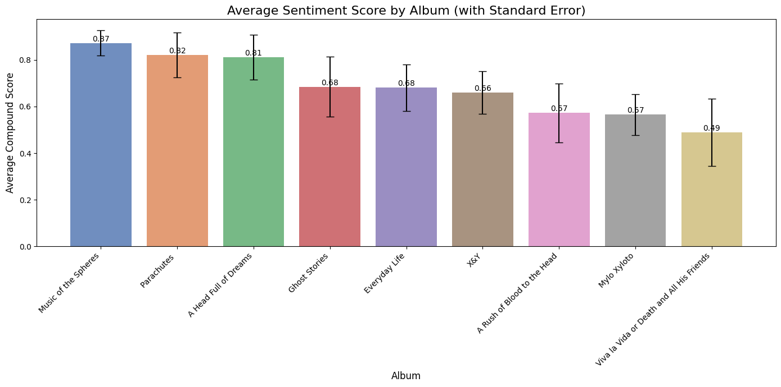

Slide 7
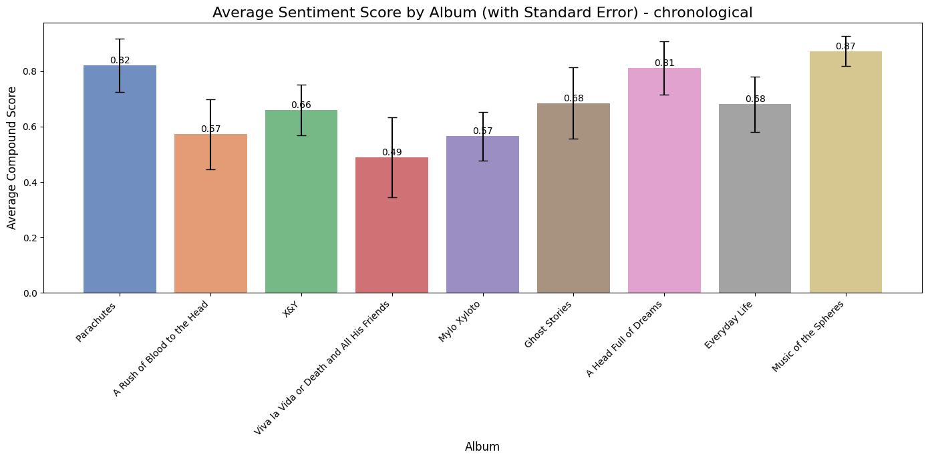

Slide 8
LBSA Results Summary
The Mean normalized compound score is 0.68, suggesting that Coldplay lyrics are slightly positive.
Standard deviation** is 0.36, suggesting high variability in sentiment polarity and notable diversity in the emotional tone of Coldplay music.
Only 25% percent of tracks have negative normalized sentiment.
Half of the tracks have a normalized compound score higher than approx. 0.90
The sentiment distribution is skewed towards positive sentiment.
The album "Music of the Spheres" has the highest average sentiment score.
"Viva la Vida or Death and All His Friends" has the **lowest (almost neutral, ncs = 0.49) sentiment score, indicating it is perceived with mixed or neutral sentiment possibly due to emotion diversity between individual tracks.

Slide 9
Pre-trained model distillBERT
Load pre-trained DistilBERT tokenizer and model
→ No pre-processing, embeddings, test parameters
Set up device for computation (GPU or CPU)
Expensive but not in our case
Define function to get sentiment scores using distilBERT.
Apply distilBERT sentiment analysis to lyrics
Define function to classify sentiment based on score
Classify sentiment into categories (Positive, Negative, Neutral) Make a flowchart diagram that can be displayed in ppt

Slide 10
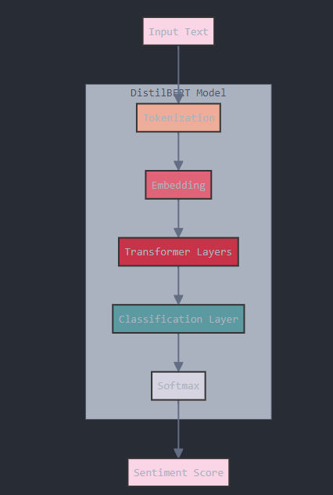

Slide 11
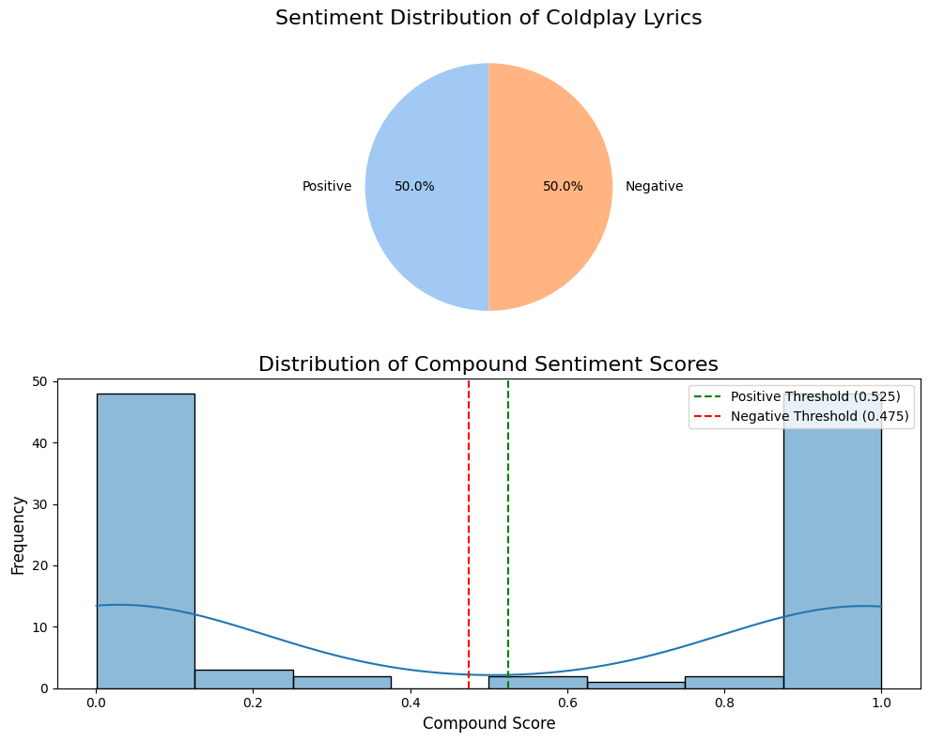

Slide 12
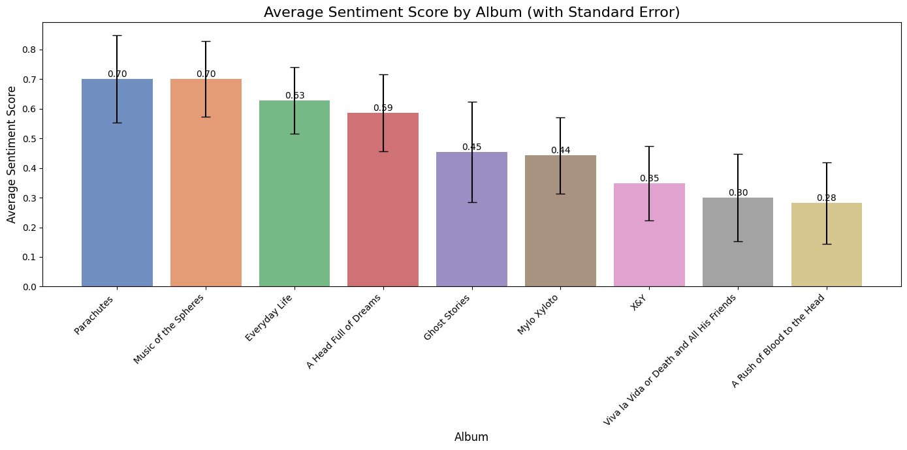

Slide 13
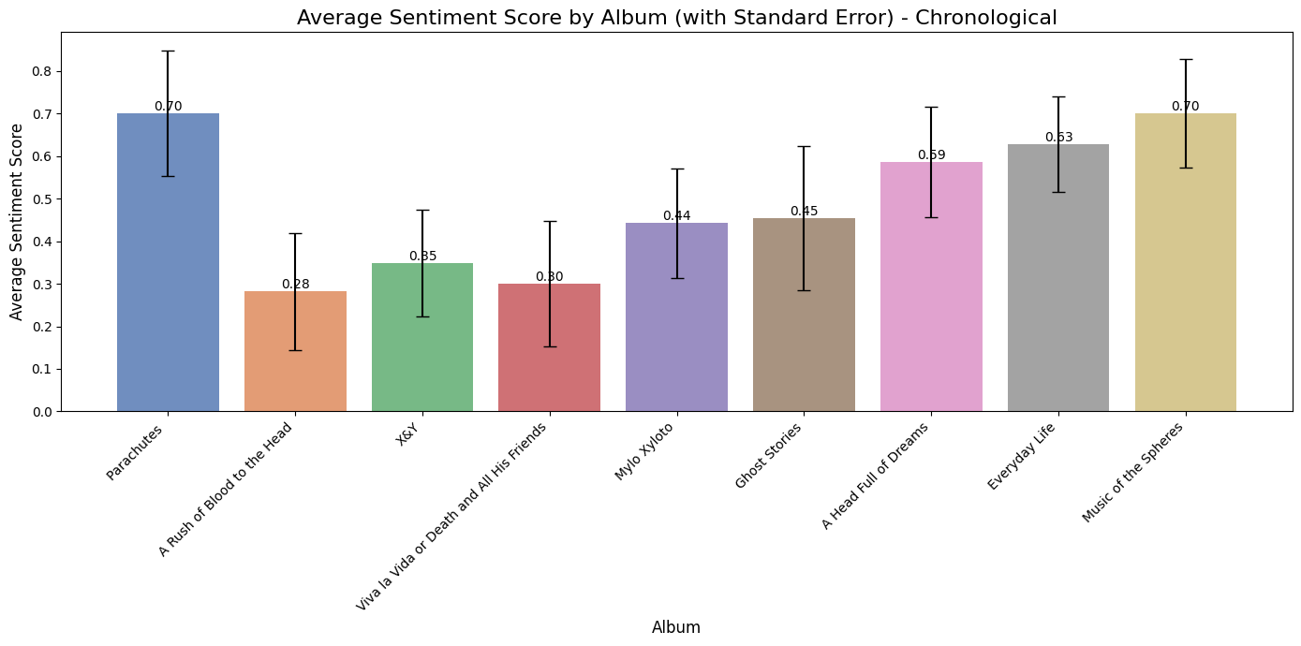

Slide 14
Summary distillBERT
DistilBERT method vs LBSA:
More polarized sentiment distribution
No neutral category
Much more confident classification
Track sentiment distribution:
Equal division between positive and negative
Overall sentiment statistics:
Normalized mean: 0.49 (indicating neutral overall)
St. Deviation: 0.47 (larger than LBSA method)
Album sentiments:
Most positive: 'Music of the Spheres' and 'Parachutes'
Smoother positive trend after 'A Rush of Blood to the Head'

